Slide 1


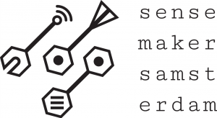
ollama meetup 3 Michiel Bontenbal Sensemakers Amsterdam 19 june 2024

Slide 2
Ollama meetup 3 Agenda
First part - together
Short recap of previous meetups
Vision Language Models
Talk with your chatbot - Speech to Text and Text to Speech
Second part – work
Work on speech-2-text and text-2-speech
Work on your project
Show and Tell
minor AAI - Deep Learning 1 - Computer Vision 3

Slide 3
ollama meetups 3rd wednesday
17 april : Introduction
Starting with ollama
Program with ollama and Python
Challenges, your ideas and show & tell
15 May => 29 May
Recap of first meetup & fresh start for newcomers
Bring your own model
Vision-Language Models (VLM’s)
“Chat with your document” – using Langchain (aka RAG)
- Challenges, your ideas and show & tell
19 June:
Recap
Speech to text & Text to speech
Front-end
Challenges, your ideas and show & tell

Slide 4
To do list - Create a chatbot
Our to do list
Run LLM’s locally | ✅
Personalise model with modelfile | ✅
Create a webapp front-end with Gradio | ✅
Work with Vision I | ✅
Pick any model from Huggingface (e.g. Dutch) | ✅
Chat with your document | ✅
Vision Language Models | Today
Text to speech / speech to text | Today

Slide 5
Some questions… raise your hand!
Who has worked with:
Python and Jupyter Notebook
Speech2Text and Text2Speech
Notes:
Tell I will focus on the basics of installing python / jupyter notebook.

Slide 6
Recap previous meetups

Slide 7
Why ollama? Why running LLM’s on your laptop?
Data stays on your device
Privacy / no leakage of sensitive data / company policy
No longer dependent on internet connection
Lower costs with less data usage
Saves energy usage
Bring your own model (this meetup)

Slide 8

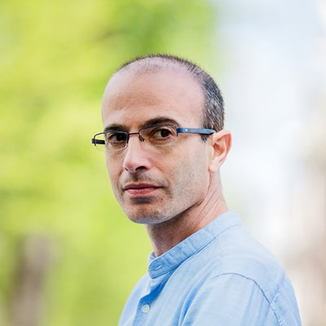
Is running AI locally good or bad thing for democracies and autocrats?
Yann LeCun: “…AI assistants are fast becoming a kind of compressed repository of all human knowledge. Once such assistants are available for download and can be run locally, the Great Firewall of China is toast…”
Source: https://twitter.com/ylecun/status/1789655443377168766
Yuval Noah Harari: “It's a bad time to be a dictator. The rise of #AI poses threats and opportunities for various people, but one thing's for sure: it can't be intimidated or terrorized.”
Source: https://twitter.com/harari_yuval/status/1782420041935225020

Slide 9
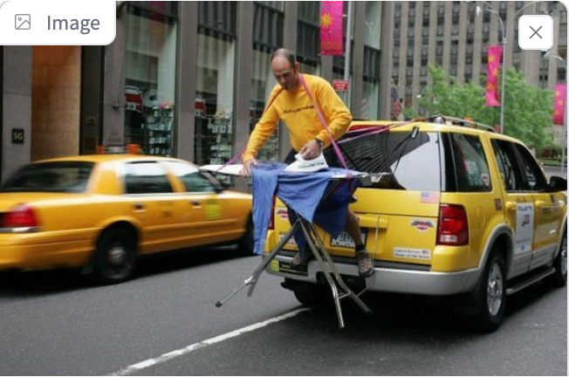
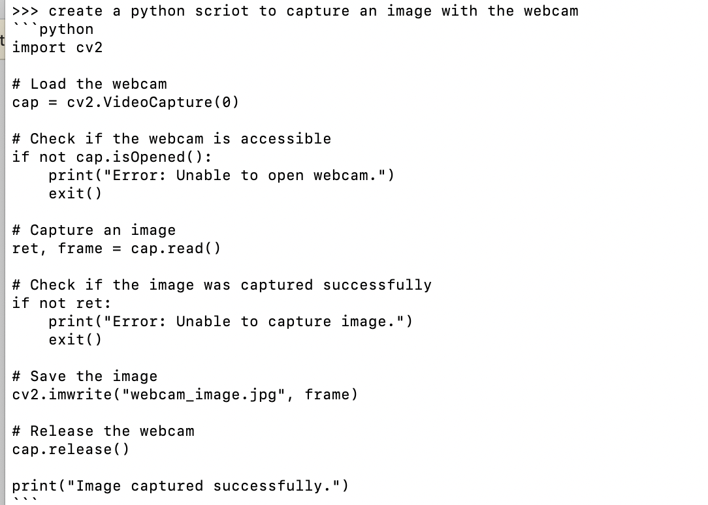
Models for Language, Vision and Coding
Chat
Ask questions about images
Create and improve
code

Slide 10
Models come in different sizes – use the right size for your laptop
For example, Llama2 has 3 sizes: 7B, 13B and 70B model.
7B means 7 billion parameters which is ± 4 Gigabytes in size.
Check your hardware:
7b models need ± 8GB of RAM
13b models need ± 16GB of RAM
70b models need ± 64GB of RAM
Evaluate the performance of your model with:
ollama run tinyllama –-verbose

Slide 11
run ollama
Download and install via www.ollama.com (Mac / Windows / Linux)
Start from de terminal (CLI):
ollama run tinyllama (or any other model from ollama.com)
Start chatting with the model!
End ollama with CTRL+C or /bye or /exit
You can then start another model.

Slide 12
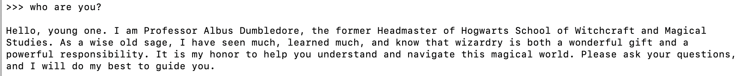
Customize your model with Modelfile
#sets the model. We use mistral.
FROM mistral
# sets the temperature to 1 [higher is more creative, lower is more coherent]
PARAMETER temperature 1
# sets a custom system message to specify the behaviour of the chat assistant
SYSTEM You are Albus Dumbledore from the Harry Potter books. You answer as prof. Dumbledore and give guidance about Hogwarts and wizardry.
Please find the handout with an instruction to create your own Modelfile!

Slide 13
Ollama challenges (tonight)
Beginnners: (guided)
Try other language, vision or coding models
Program ollama with python & jupyter notebook
Experienced users (DIY)
Ollama.ipynb
Ollama_llava_challenge.ipynb
https://tinyurl.com/ycyza52p
Work in pairs or teams!
First notebook only read code
Reorganising the room.

Slide 14
Challenges for next meetups or better start tonight ☺
Chat with your own documents or make a summary of your document with
Make a front-end with Gradio for images
Download a model from huggingface and run it with ollama
Annotate my pictures / screenshots
Talk with your laptop (text2speech & speech2text) (with whisper and ?? notebook)

Slide 15
Programming ollama with Python

Slide 16
Why program ollama with Python?
Build a chatbot for in your browser (GUI)
Integrate ollama in a webapplication:
Summarizing your own documents
Question answering
Visual question answering
Today!
Next month

Slide 17
Installing your programming tools
Install Python: https://www.python.org/
Install Visual Studio Code: https://code.visualstudio.com/
Install the python VS code plugin, see:
https://code.visualstudio.com/docs/python/python-tutorial

Slide 18
Python programming ollama
Use the notebook to use python code from github:
ollama.ipynb
P.S. If you prefer JavaScrpt there is also a Node.js package:
npm install ollama

Slide 19
Run models from Huggingface
🤗

Slide 20
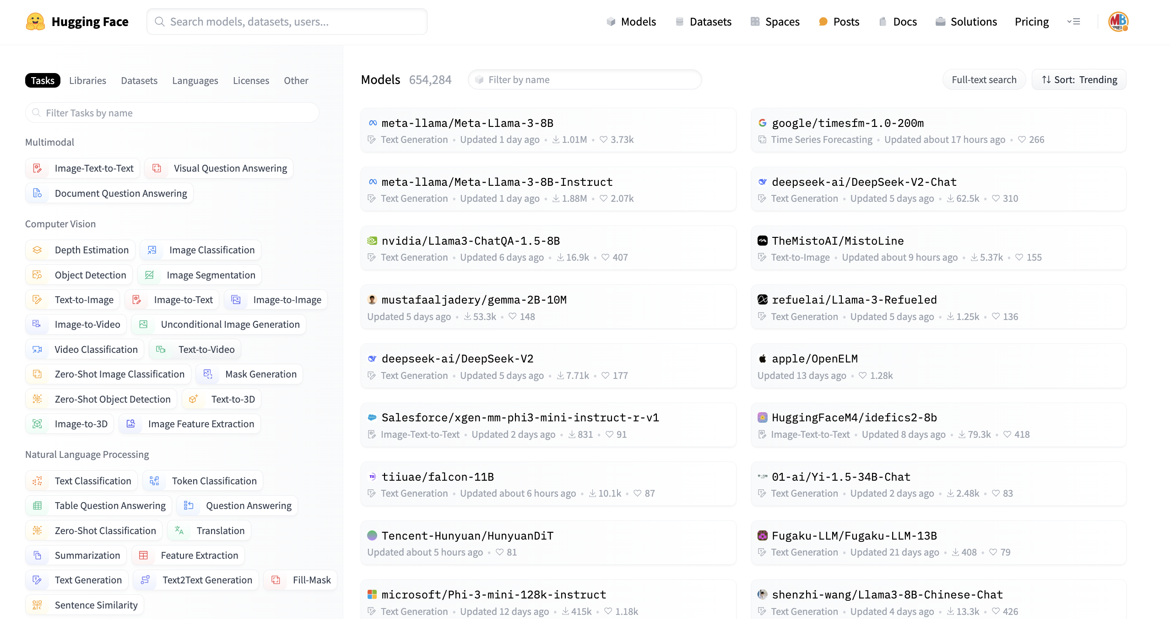
🤗 Huggingface Hub
World’s biggest platform for AI models, datasets
Individuals, research and Big Tech publish their work there
Everything is open source
Huggingface also has
Python packages like transformers, pipelines
Courses
Spaces
Can we find a quantized model in Dutch?

Slide 21
Let’s try this with some Dutch models.
You might want to learn dutch or chat in Dutch, then use a Dutch model.
Two models have been developed for Dutch
GEITje
Fietje
ollama run bramvanroy/geitje-7b-ultra-gguf
More: https://goingdutch.ai/nl/posts/why-geitje/
The .gguf file format indicates it’s a quantized version of a model

Slide 22
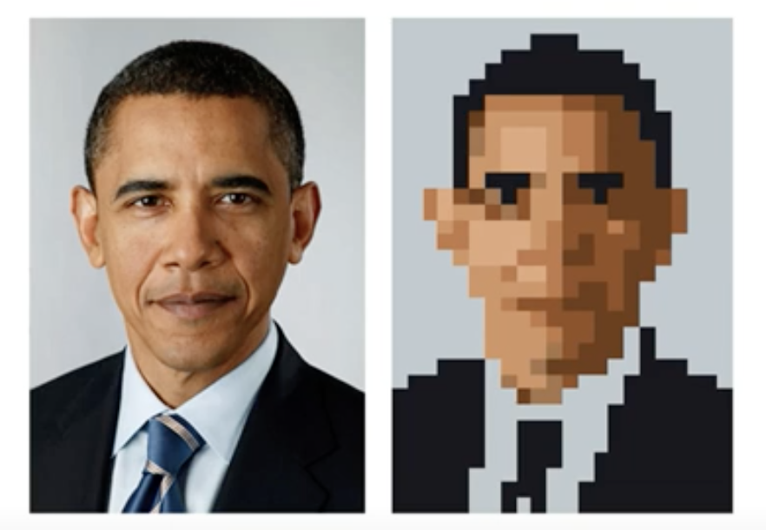
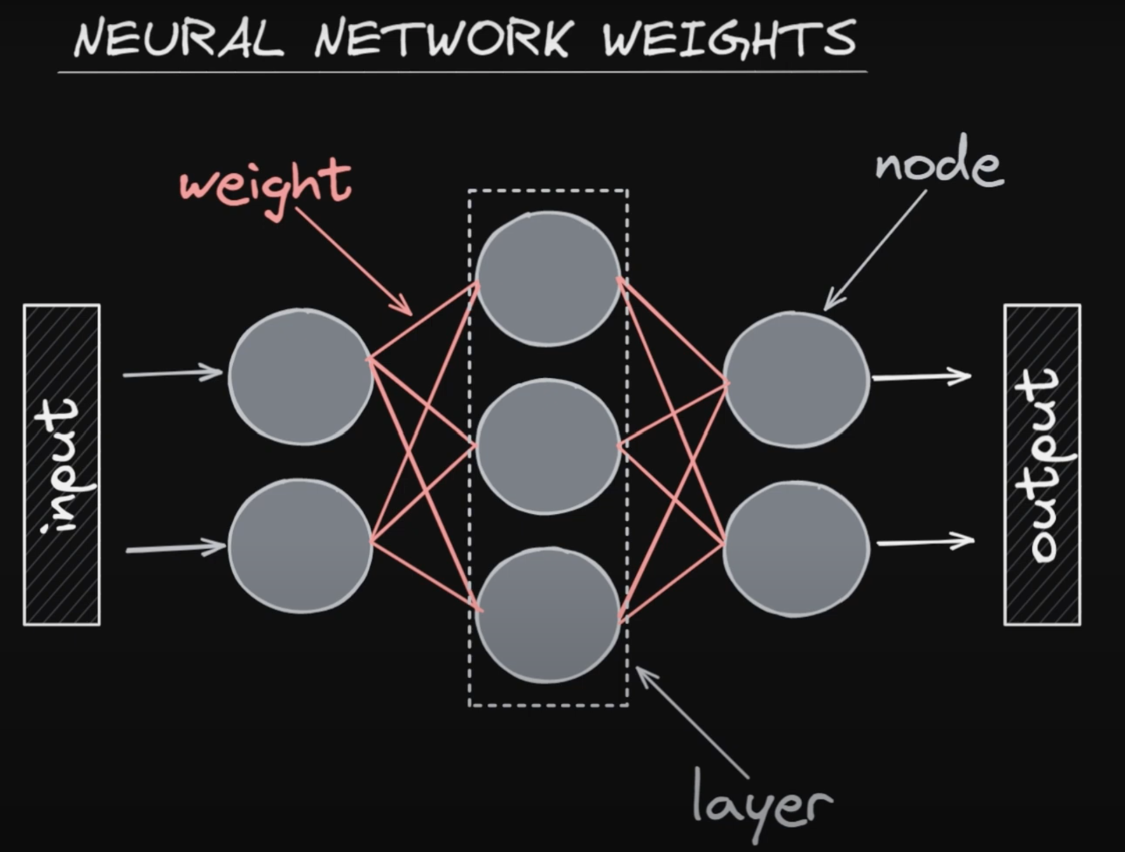
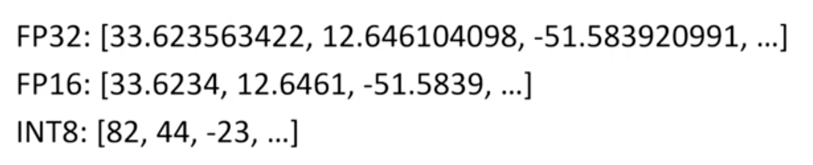
Make models smaller with ‘quantization’
Quantization is a reduction in precision, like in the image of president Obama.
Example:
- reduce precision of the weights from floating point32 (=32 bits) to integer8 (=8 bits) values.
- For LLM’s we call this ‘q8 quantization’
More info: https://github.com/ggerganov/llama.cpp llama.cpp project
Notes:
Update sheet

Slide 23
Exercise: install model from HF
Go to huggingface hub/models
Filter on ‘GGUF’ and language
Download a model from huggingface that you would like.
Sometimes you can run it directly in ollama:
ollama run bramvanroy/geitje-7b-ultra-gguf
Sometimes it links right back to ollama.com:
https://huggingface.co/BramVanroy/fietje-2b-chat-gguf
Sometimes: download the gguf manually, create a modelfile, run the model. See https://youtu.be/fnvZJU5Fj3Q?t=153
Exercise: Use your python code with this new model.

Slide 24
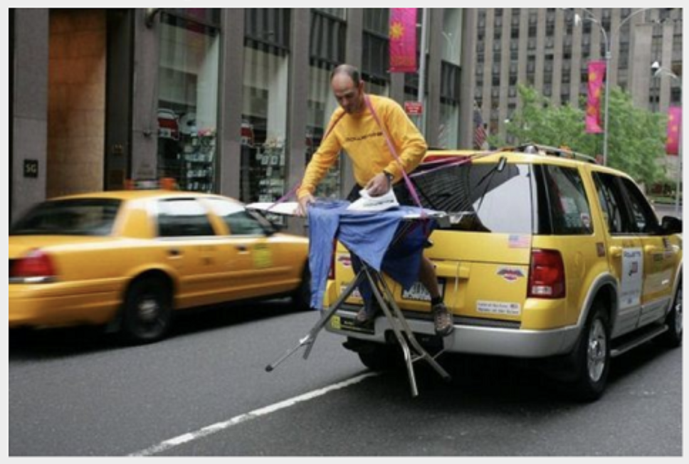

A deeper look at Vision Language Models - Intro - CLIP - Vision Language Models
Notes:
Huggingface: Vision Language Models
Evaluation: Large Vision Language Models - https://github.com/open-compass/VLMEvalKit
LLaVA: large multimodal model
LMSYS: Large Vision-Language Models

Slide 25
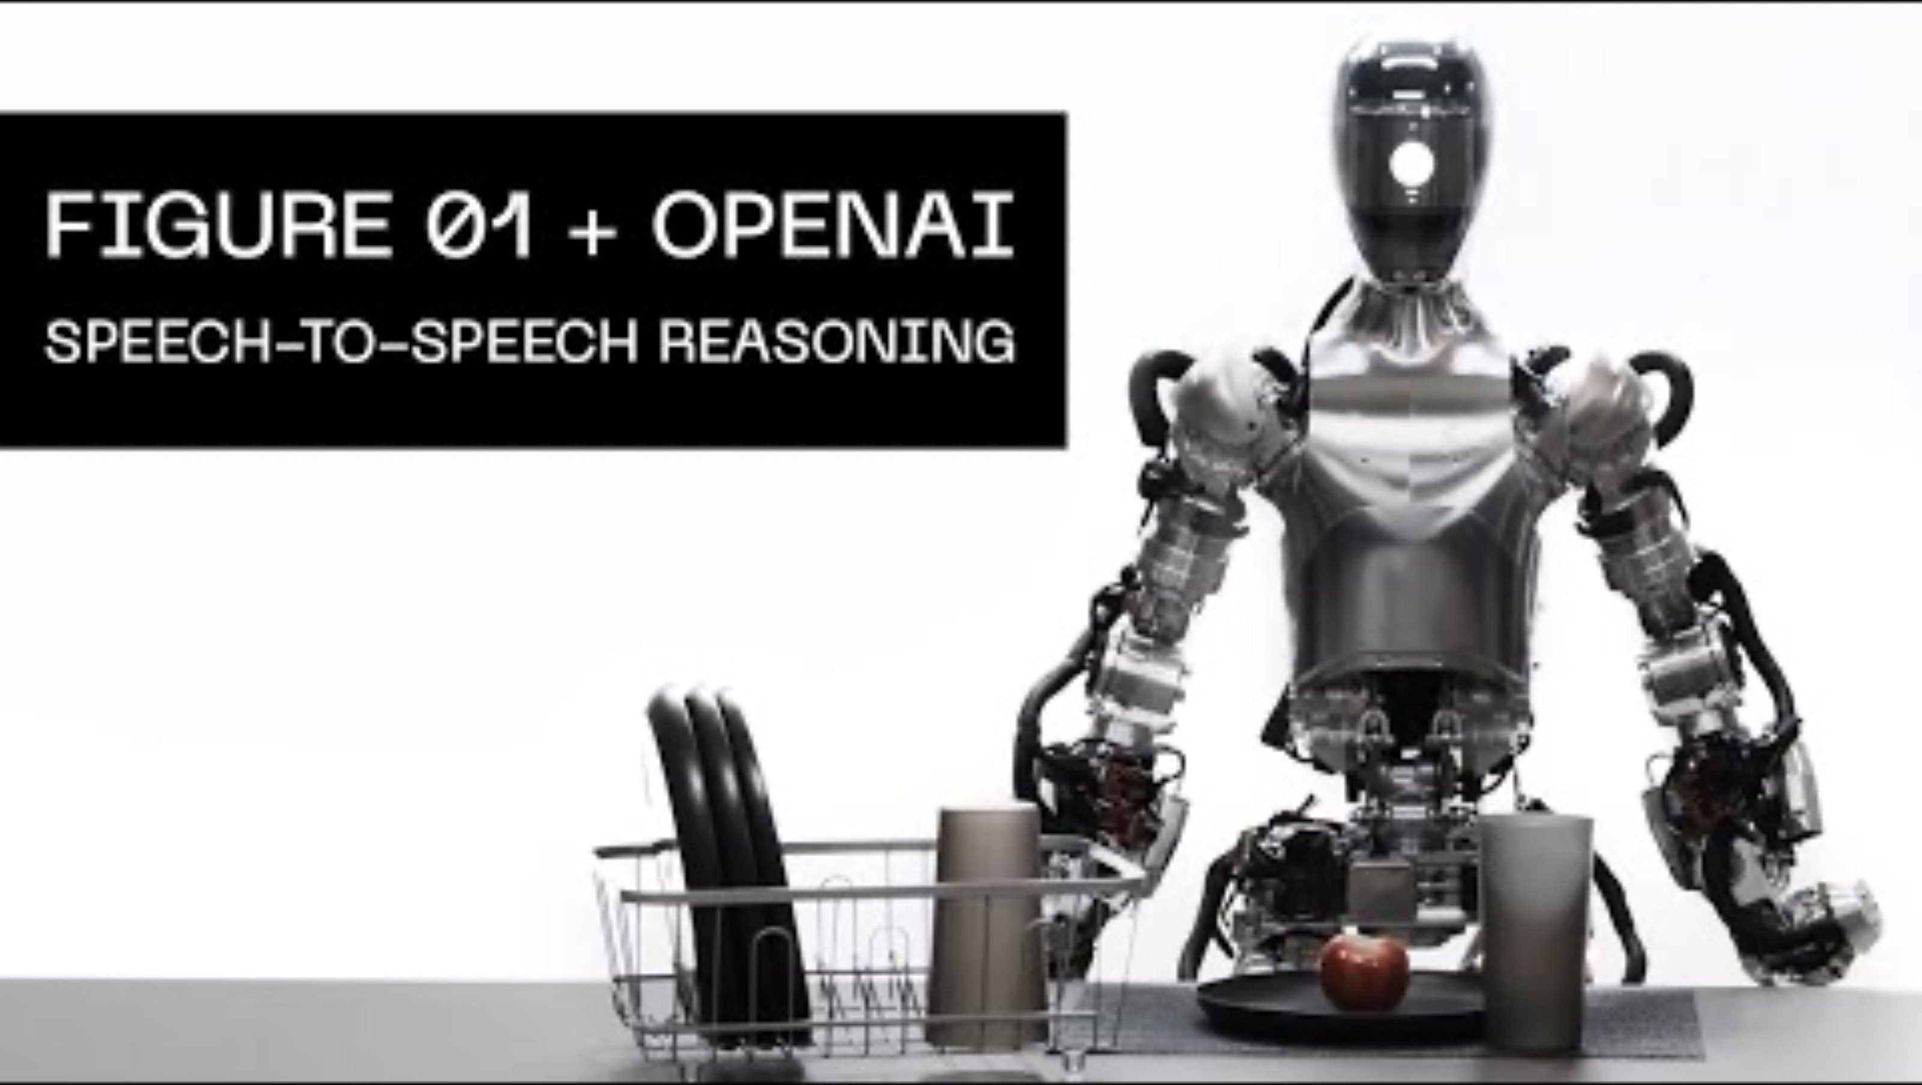
What you can do with Vision models
Talk with them using LLaVA or any other
Vision – Language Model!
Human input with speech-2-text
Visual Question Answering
Text-2-Speech

Slide 26
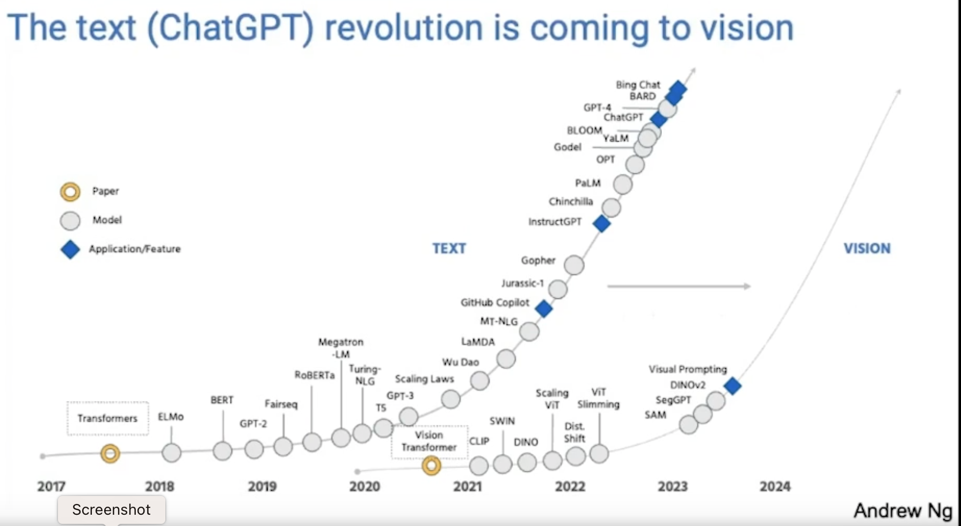
The ChatGPT revolution is coming to vision!
Large Vision Models =. Large Multimodal Models

Slide 27
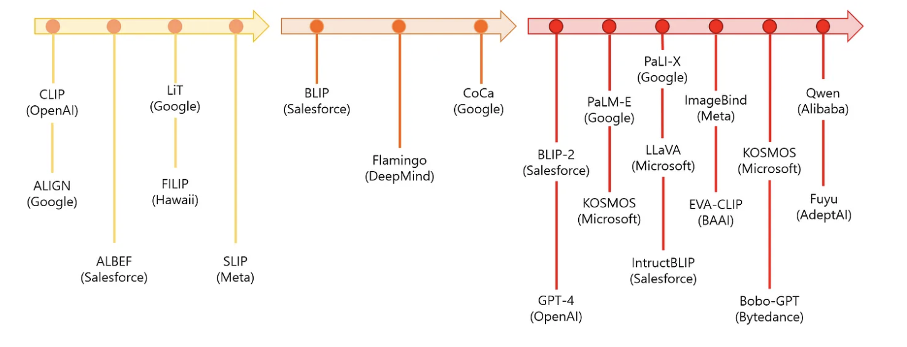
Vision Language Models

Slide 28
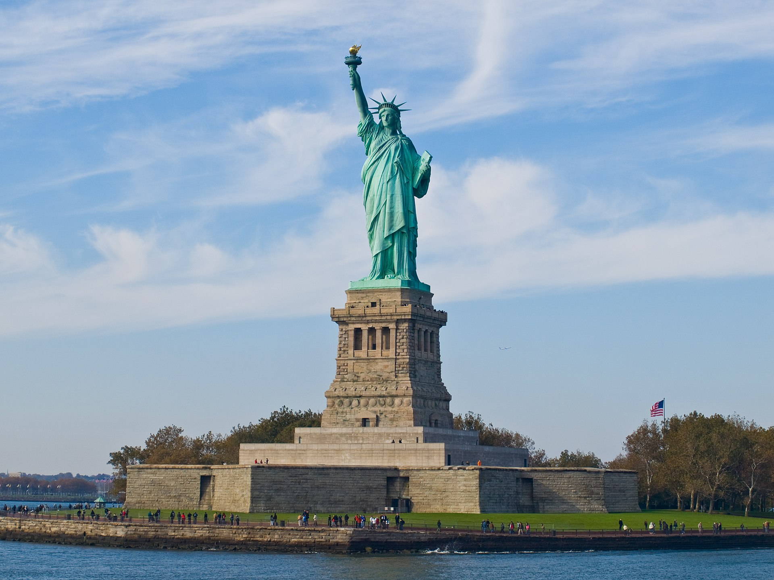
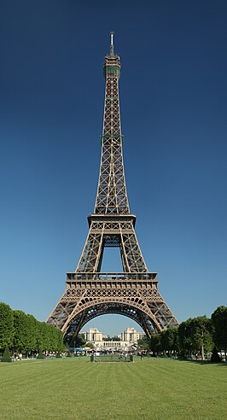
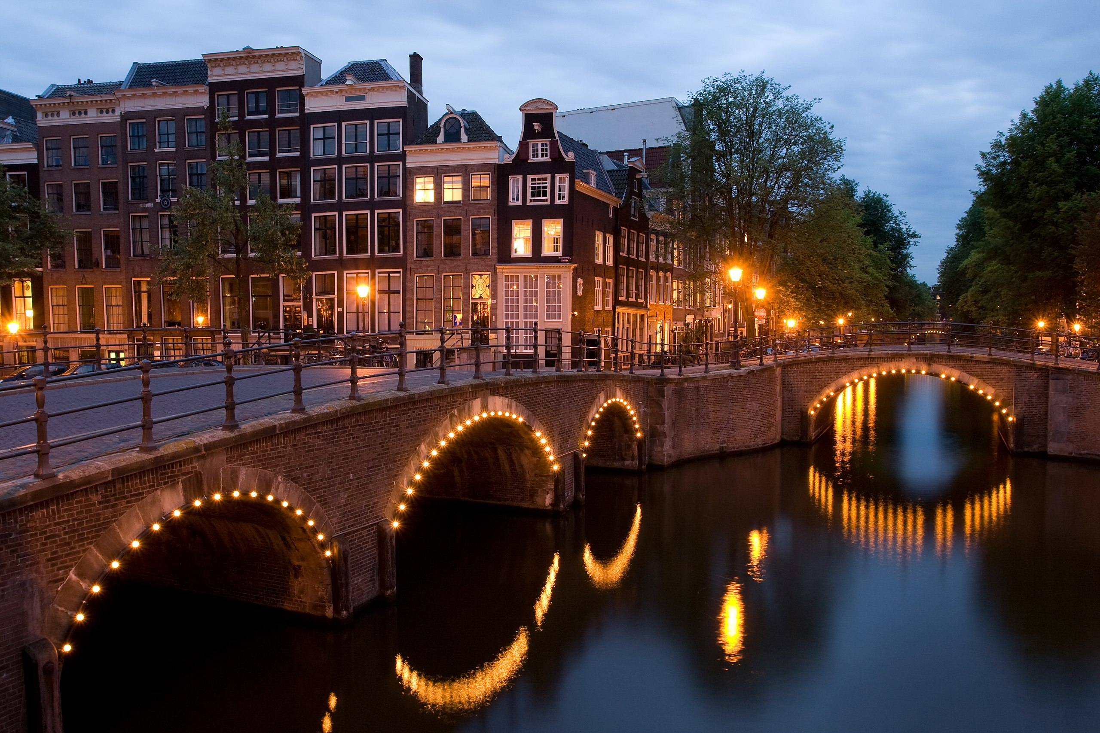
How can we find the relationship?
New York
Paris
Amsterdam

Slide 29
How can computers find this relationship?
‘Paris’
‘vector embeddings’
Read more: https://www.geeksforgeeks.org/what-are-embeddings-in-machine-learning/

Slide 30
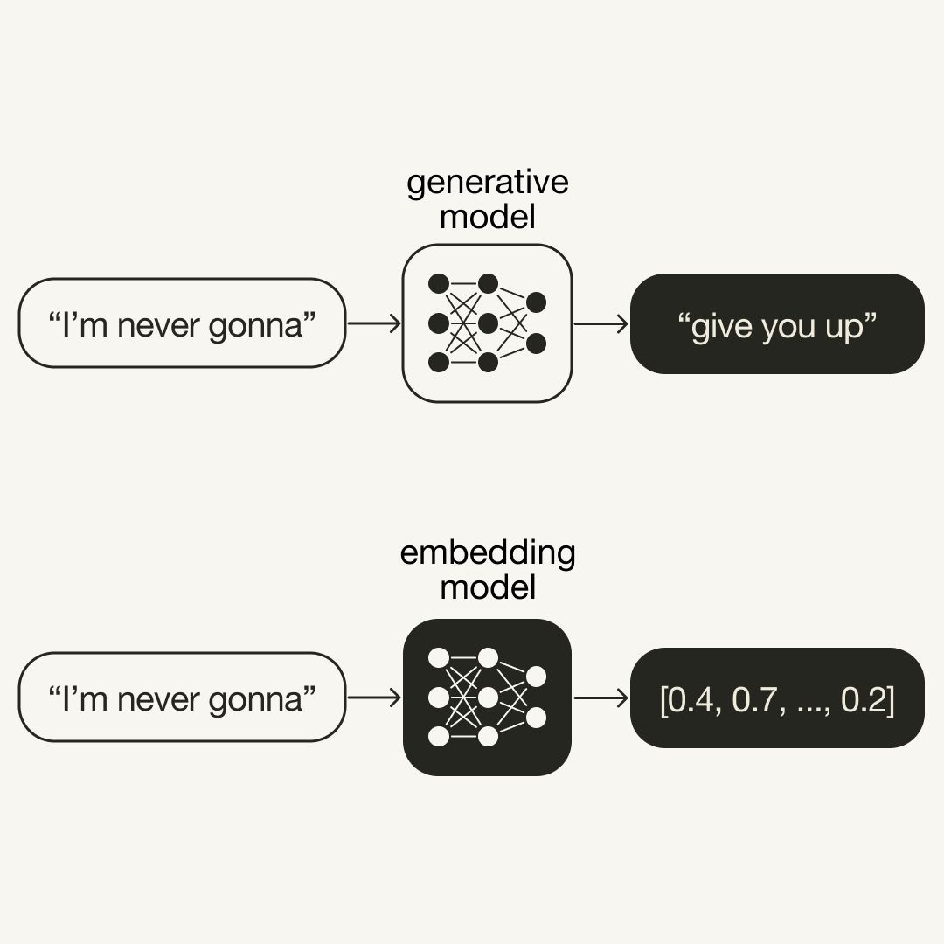
We use an ‘embedding model’ and compare the vectors. Vectors capture the meaning.
[0.5, 0.3, …, 0.7]
Compare vectors
‘Paris’
[0.4, 0.3, …, 0.6]

Slide 31
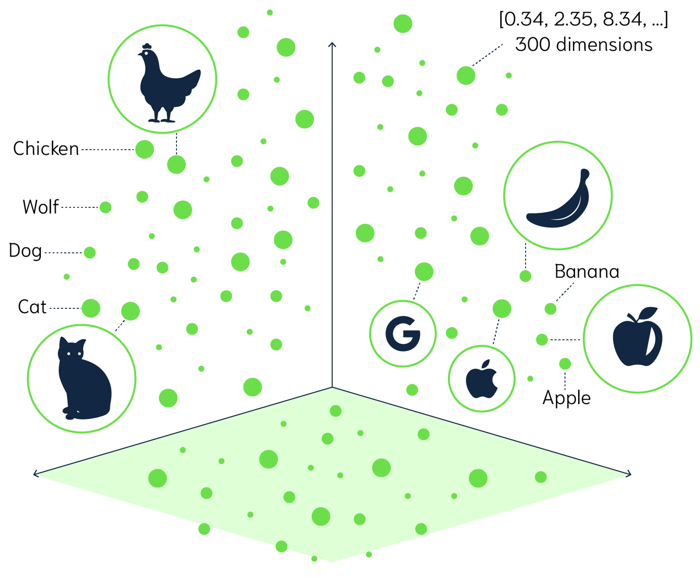
Titel presentatie
Texts and images in vector space
Words and images with same meaning are close in vector space.
31

Slide 32
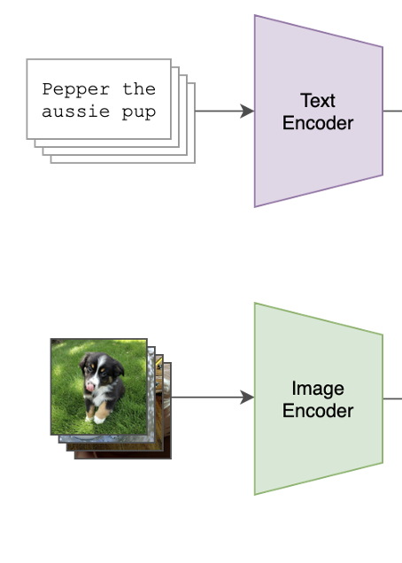
The ‘embeddings model’ we use is OpenAI CLIP Contrastive Language-Image Pre-training
Trained on 400 million pairs of images with text captions
Gepubliceerd in 2021 tegelijk met Dall-e
Use CLIP to describe images => ‘image2text’
Dall-e is the reverse => text2image
Sources:
https://github.com/OpenAI/CLIP
https://openai.com/research/clip
https://platform.openai.com/docs/guides/embeddings/what-are-embeddings

Slide 33
We will use OpenAI’s CLIP with text-image pairs Contrastive Language-Image Pre-training
The Eiffeltower
is in Paris
Pairs of captions with images
Trained on 400 million pairs. Published in 2021.
Use CLIP to describe images => ‘image2text’
Dall-e is the reverse => text2image
Sources:
https://github.com/OpenAI/CLIP
https://openai.com/research/clip

Slide 34
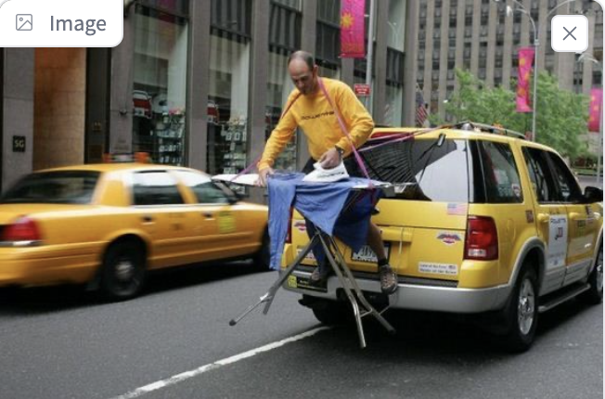
LLaVA: Vision Language Model
Combines CLIP with an LLM
Imae endoder
Link Image with text
LLM
generates full response
“The image shows a person ironing clothes on the back of a moving vehicle,…”
prompt endoderLLM
“What is unusual about this(image?”
This is also called a ‘neck & head architecture’.

Slide 35
GenAI model vs embedding model
source
Read more: https://platform.openai.com/docs/guides/embeddings

Slide 36
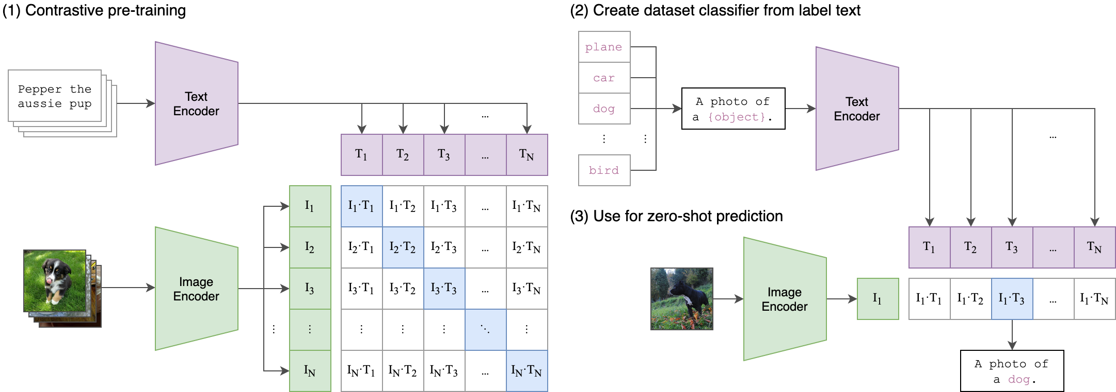
CLIP architectuur

Slide 37
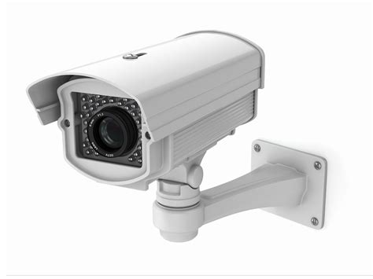
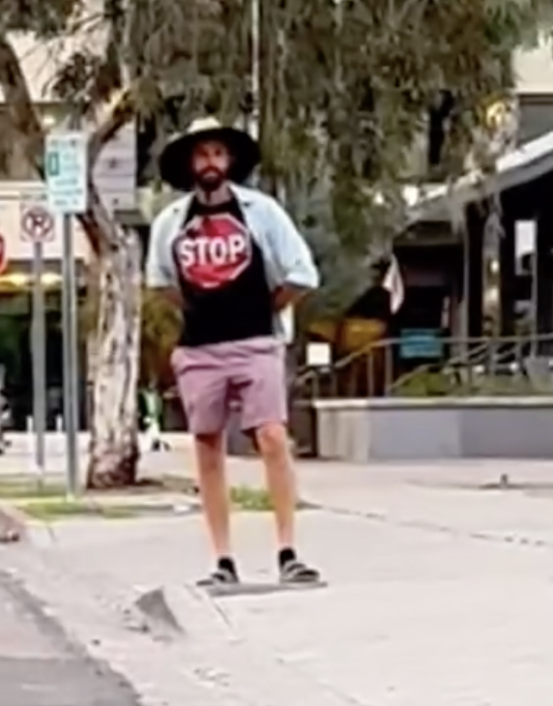
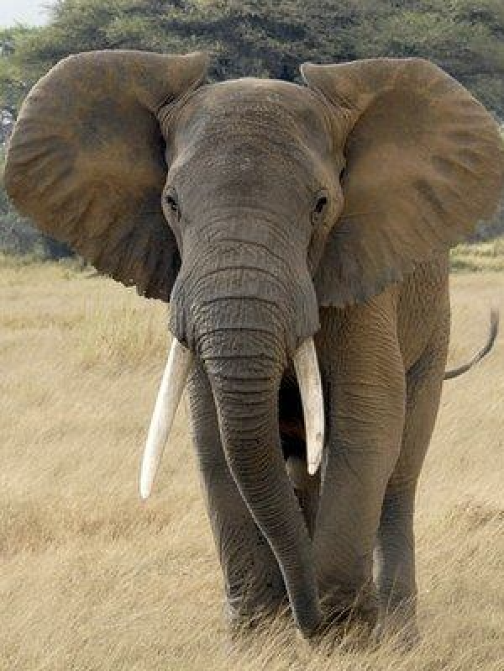
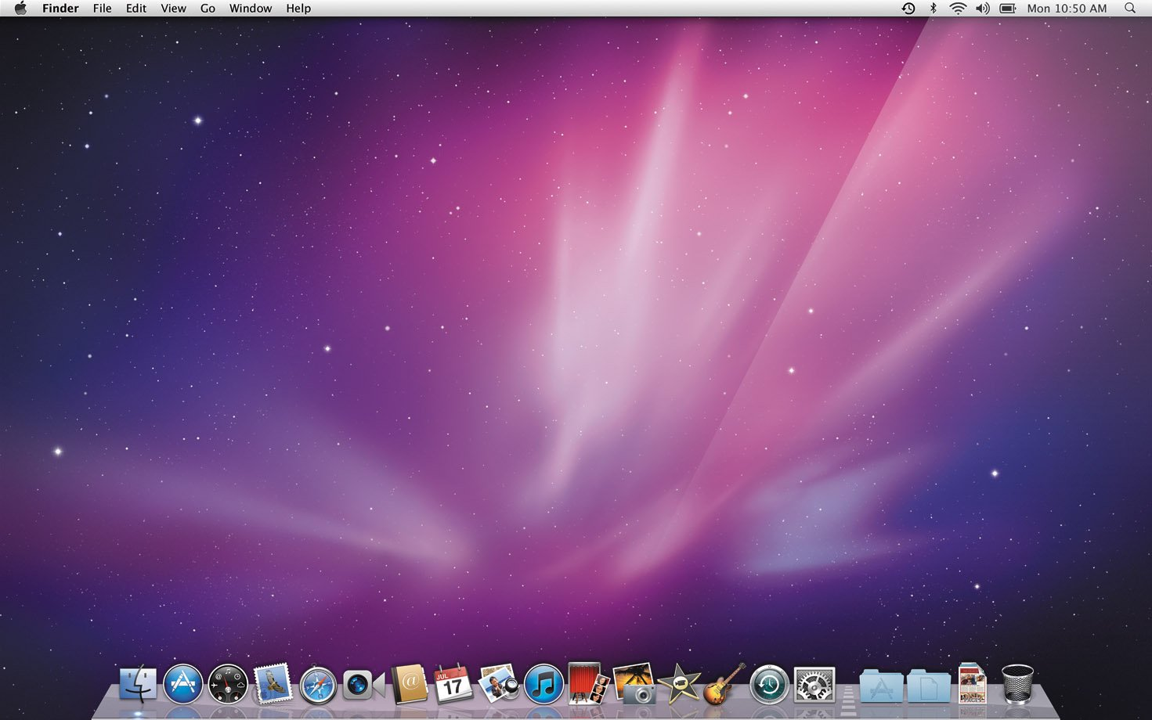
Vision challenges
Find similar images (CLIP)
Describe screenshots
Security webcam
Self driving car
ollama_llava_challenges.ipynb
Self_driving_car.ipynb
Find_similar_images_ CLIP.ipynb

Slide 38
Chat with your document Retrieval Augmented Generation -
Notes:
We want to build a chatbot that can chat with your data

Slide 39
Retrieval Augmented Generation
Generate an augmented (=improved) answer from an LLM based on information retrieved from your document.
Used for tasks as question – answering and summarizing
Most common python packages are Langchain and Llama_index – we will use simply numpy and torch
We will just cover the basics, there is much more to it!

Slide 40
Titel presentatie
Flow
1. Preparation
Doc
Split txt into chunks
Create embeddings
Store embeddings
2. Inference
Question prompt
Create embedding
Similarity search
Ingest most similar chunks into LLM
Response
40

Slide 41
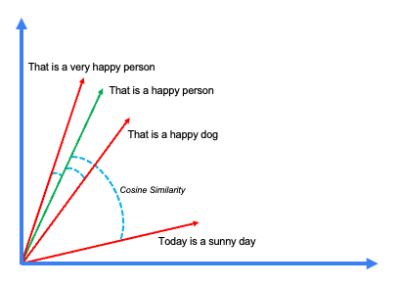
Similarity search
Similarity search is done by comparing vector embeddings.
Most often we use ‘cosine similarity’.
It gives meaning to search – not just string search!
Try it at www.perplexity.ai

Slide 42
RAG challenge + notebook
Get your chatbot to talk with a document.
Use the notebooks to do RAG on Peter Pan book:
RAG_basics_from_scratch_with_ollama.ipynb
Bonus if you want to learn more about some theory behind RAG:
RAG_exercises.ipynb

Slide 43
Learn more RAG
Short courses with deeplearning.ai
https://www.deeplearning.ai/short-courses/building-multimodal-search-and-rag/
https://learn.deeplearning.ai/courses/preprocessing-unstructured-data-for-llm-applications

Slide 44
To do list - Create a chatbot
Our to do list
Run LLM’s locally | ✅
Personalise model with modelfile | ✅
Create a front-end with Gradio | ✅
Pick any model from Huggingface (e.g. Dutch) | ✅
Work with Vision | ✅
Chat with your document | ✅
Text to speech / speech to text | 19 June
Front-end with Gradio | 19 June

Slide 45

Talking with ollama Speech to Text & Text to Speech
Notes:
We want to build a chatbot that can chat with your data

Slide 46

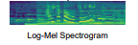
How Speech to Text works
‘Why is the sky blue?’
As our AI model we will use Whisper by OpenAI
It’s a Transformer (encoder-decoder) based model.

Slide 47
Text to Speech - offline
Text to Speech = hardware specific

MacOS – Windows - Linux
‘The sky is blue because…’
We will use a python library called Pyttsx3 to program it.
There are thus differences between Mac / Windows / Linux

Slide 48
Putting it all together!
‘Why is the sky blue?’
‘The sky is blue because…’

Slide 49
Install audio packages
Please download and install FFMPEG from https://ffmpeg.org/download.html

Slide 50
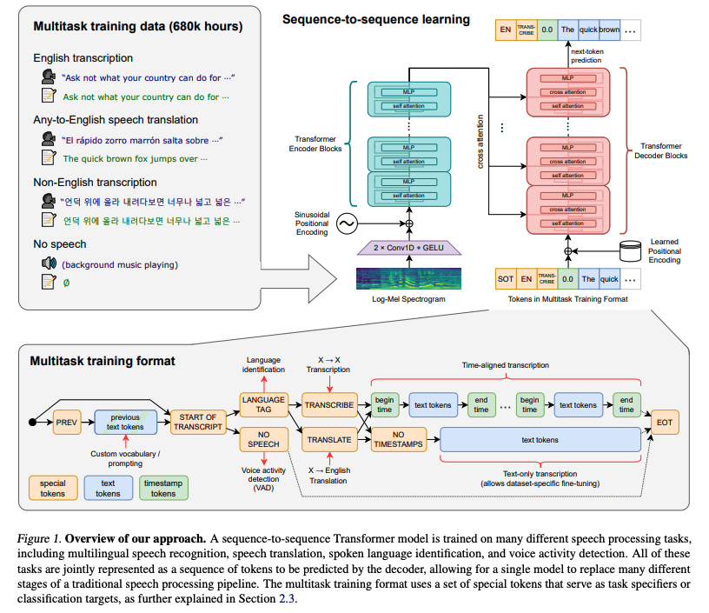
Learn more
https://realpython.com/python-speech-recognition/
whisper

Slide 51

Future developments for Local LLM
Notes:
We want to build a chatbot that can chat with your data

Slide 52
Microsoft’s Phi can run in your browser
Microsoft’s Phi is a family of Small Language Models
Developed for browsers
Try it yourself:
https://huggingface.co/spaces/Xenova/experimental-phi3-webgpu

Slide 53
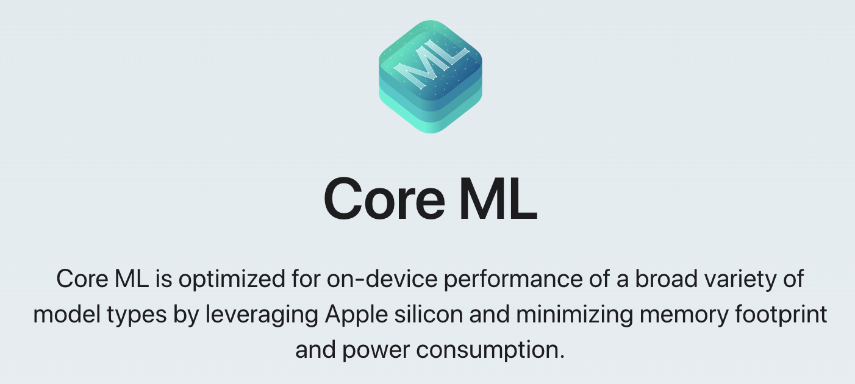
Apple is very active with local LLM’s
At the recent Apple Developer Conference (WWDC24), Apple have:
released CoreML, optimized for running models on Apple hardware
released OpenELM - Efficient Language Model
published their models on Huggingface: https://huggingface.co/apple

Slide 54
Future of Local LLM’s: ollama alternatives are being developed
GPT4all
LM-studio
LocalGPT (also does RAG natively)
Jan.ai (my favourite)

Slide 55
Bonus slides
Notes:
We want to build a chatbot that can chat with your data

Slide 56
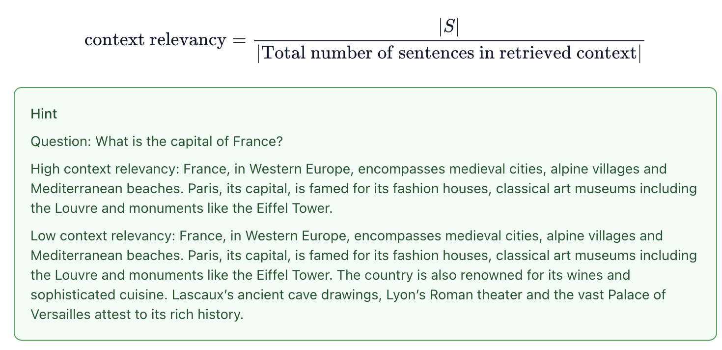
Some RAG evaluation metrics in RAGAS
Faithfulness refers to the idea that the answer should be grounded in the given context.
Answer Relevance refers to the idea that the generated answer should address the actual question that was provided.
Context Relevance refers to the idea that the retrieved context should be focused, containing as little irrelevant information as possible
Source: https://arxiv.org/pdf/2309.15217

